Slide 1



DATA ANALYST PORTFOLIO PROJECT
BANK LOAN ANALYSIS
Power BI
MySQL

Slide 2
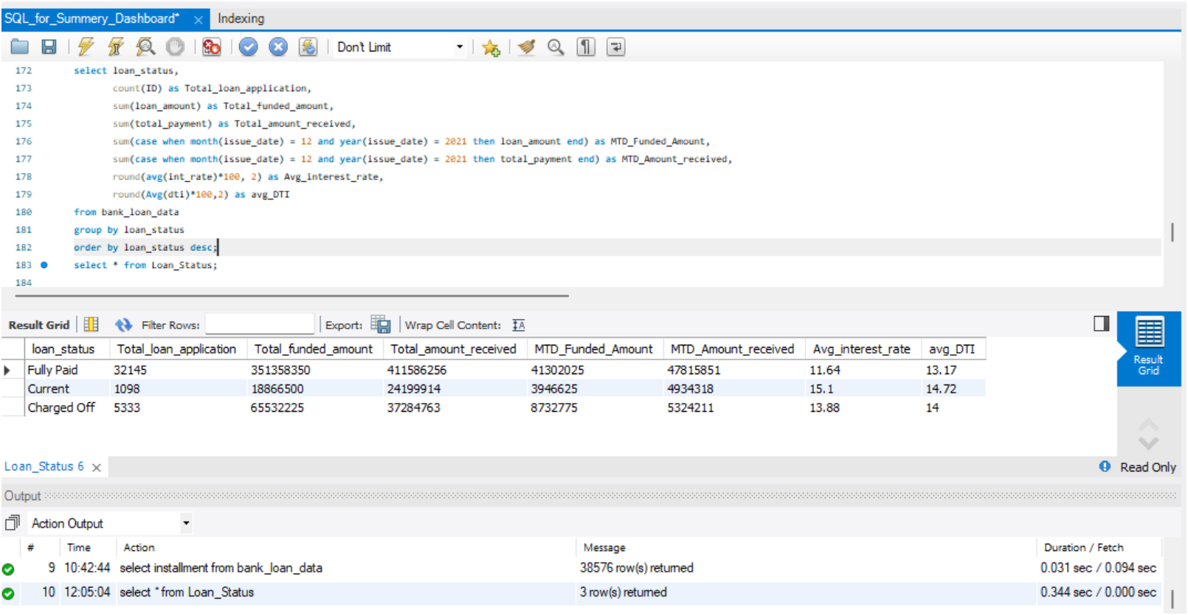
MySQL
WRITING
QUERIES

Slide 3

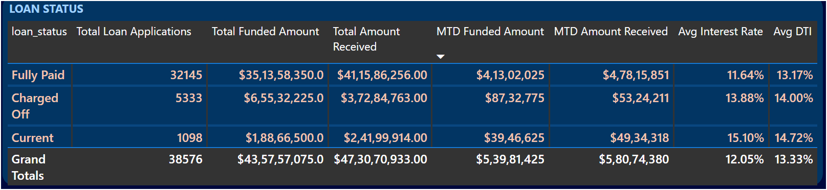
SQL
FIRING SQL QUERIES TO SOLVE THE BUSINESS PROBLEMS
COMPARING RESULTS WITH POWER BI

Slide 4

DATA ANALYST PORTFOLIO PROJECT
BANK LOAN ANALYSIS
POWER BI

Slide 5


POWER BI
CONNECTING TO
MySQL

Slide 6
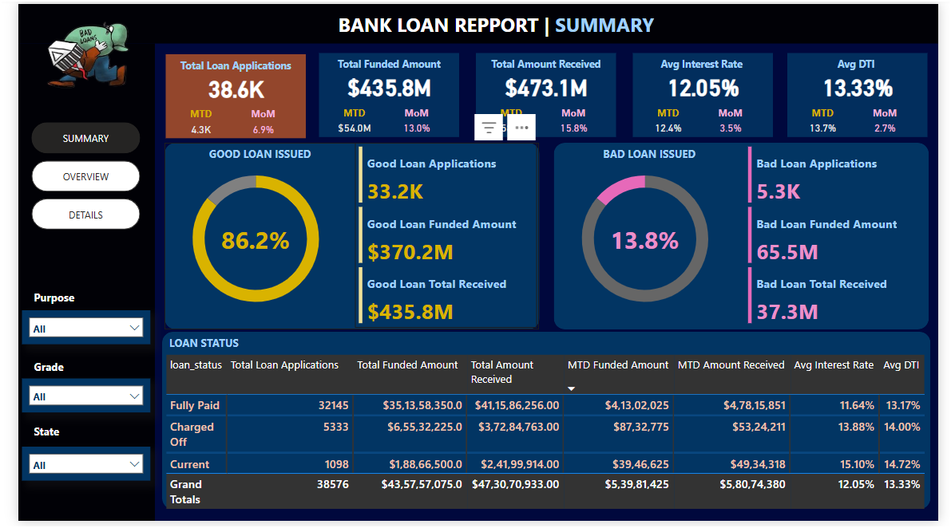
POWER BI

Slide 7
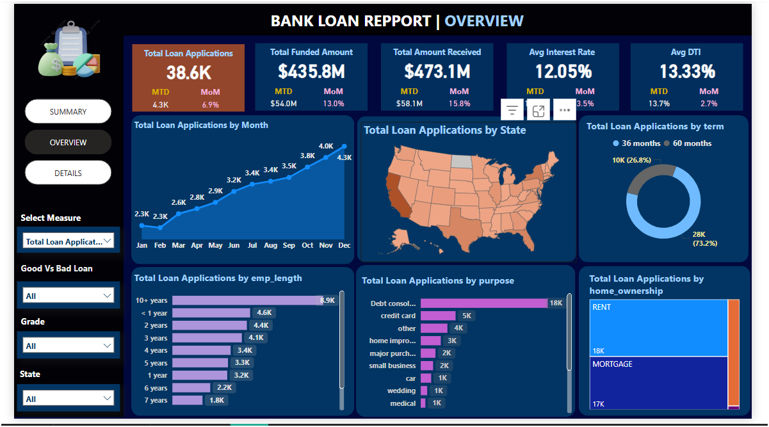
POWER BI

Slide 8
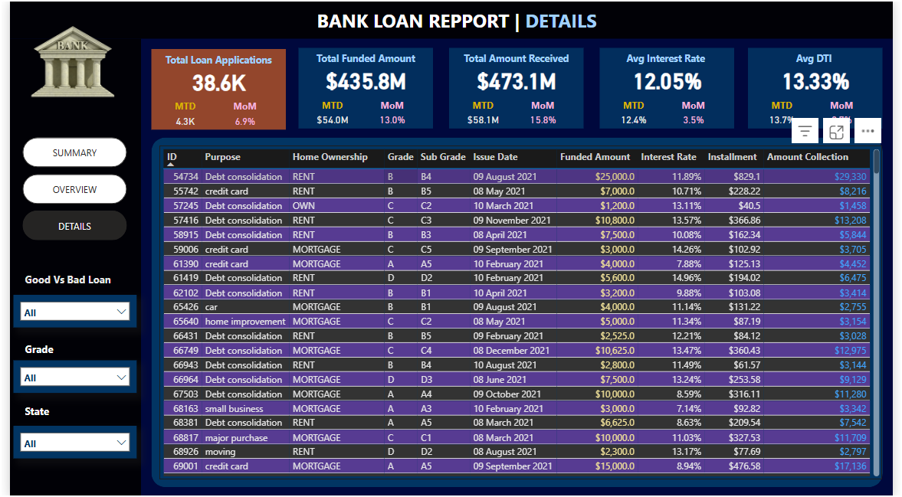
POWER BI

